Slide 1
TIC TAC TOE
python
pygame

Slide 2
CONTENTS
01
Intro
02
Code Components
03
How to play
04
Conclusion

Slide 3
01
Intro
Talk about team and game

Slide 4

1
Intro
THe Team
The team consists of 3 :
Yasmin salah
Ahmed Mohamed
Ahmed Maher

Slide 5


1
Intro
Design of game
THe game designed by pygame library in python helps to make code into game and interaction
Codes
THe syntex is python~s syntax

Slide 6
Code Components
02
Talk about code and how type and the function of game help in make it

Slide 7
2
pygame
*constant variables: we defined some variables with constant values so we can use them many times
within our code.
*We created a 2d array called board that carries all positions of our game board (The table)
with the value of character played either X or O [if the cell is empty it will contain space ' ']
*We have set the size of the screen to 600x600.
*We have set the background color of the screen to (4, 60, 83)
*The game caption is set to "Play multiplayer Tic Tac Toe game".
*We defined a user function called draw_lines() that draws all lines of the board (The table) at the beginning of the game.
*We defined another user function called insert() that takes the board, the player tile ('X' or 'O'), and the position where the player wants to insert the character (row and column) as parameters, and saves these values in the board array and when .
*We defined another user function called print_board() that prints X or O on the screen at the position which was saved
to the board array every time it is being called.
*We also defined a user function called is_board_full() that returns true if the board was occupied and returns false
*We then defined four functions draw_horizontal_win(), draw_verticle_win(), draw_normal_diagonal_win(),
draw_reverse_diagonal_win(), all of them draw a line on the row, column or the diagonal that occupied with equal characters (win a player wins)

Slide 8
2
python code
if it was not occupied yet.
*Then finally we defined that last function which is called main() that repeatedly take the position where the user want to
place his character, call insert() function to insert it and call print() to print the current
board (with the added character) until one of the players win or all the cells are
occupied(tie).
* After we have defined all these functions we called the function draw_lines one time at the beginning for drawing the game
board lines then we called the function pygame.display.update() for updating the screen display with the lines drawn.
* Then we used a while loop that will break when a variable called running is equal False (when the pygame quits),
then we made a for loop that passes through pygame.event.get() function so we can know if the event type was MOUSEBUTTONDOWN
because if so the position of mouse will click will be saved and sent to the insert() function so that it updates the board array
then we call the print_board() to update the printed board on the screen, then we call the main() function out of the for loop
that passes throught the pygame.event.get() function and inside the while running loop, so that if the mouse was not clicked ,he can play by typing the position and the character ('X' or 'O') value on the keyboard and it will be sent to the main() function
that will do the same functionality instead of the mouse.
Add your words here,according to your need to draw t text box size
Add your words here,according to your need to draw the text box size

Slide 9
2
python
Finally Function is_winning():
*It is the function that checks if either player ‘X’ or player ‘O’ win. First, we put a value of ‘T’ in the datatype character. Second, we make a for loop that goes in every element in the 2D array, if one of the players made 3 Xs in a column, this takes the game board as a parameter and returns ‘X’ if the first player wins, ‘O’ if the second player wins, or ‘T’ if no one wins.
*After that it calls on of the following functions draw_horizontal_win(), draw_verticle_win(),
draw_normal_diagonal_win(), draw_reverse_diagonal_win() depending on the row, the column or the diagonal that contain equal characters.
* We have done this code on checking row code, the main diagonal and the reverse diagonal. The different between them is the array elements.

Slide 10
03
How to Play
Talk about how game is played and how to win

Slide 11


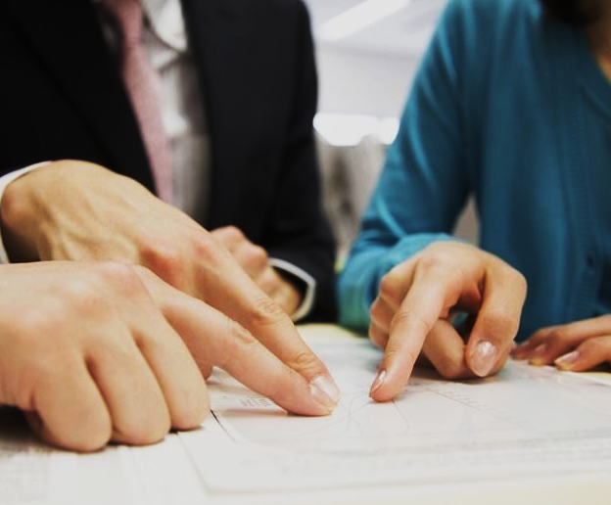
3
How to play
Mouse
palyers
win
you will use the mouse to click in place u want to play and click on it
must be multi players to play
to win you should make 3X or 3O in
Shape horizontally or vertically or diagonlay

Slide 12
04
Conclusion
cocnclusion about game

Slide 13
4
conclusion
1
2
3
componunts of code which use pygame and python
to play should to two players and uses mouse and everyone choose x Or o
the game made by team

Slide 14
4
conclusion
Resouces
uses pygame tutriol to design the game
https://www.pygame.org/docs/

Slide 15
THANK YOU FOR LISTENING

